Slide 1
Consumers surplus

Slide 2
The doctrine of Consumer's Surplus was originally stated by the French engineer economist Arsens Jules Dupuit in 1844. Later Alfred Marshall developed this concept in his famous work ‘Principles of Economics'.
In our daily life, we consume many commodities that are available cheap. Example: salt, match box news papers, etc. The utility from these commodities is so high that we would be prepared to pay higher prices for them than we actually pay.
The higher price that consumers are prepared to pay, over and above what they actually pay, indicates surplus satisfaction. This surplus satisfaction is consumer's surplus.

Slide 3
Definition of Consumer Surplus
1.According to Alfred Marshall, "The excess of price which he (consumer) would be willing to pay, rather than go without the thing, over that which he actually does pay, is the economic measure of this surplus satisfaction. It may be called Consumer's Surplus".
2. Samuelson described consumer's surplus as follows: "There is always a gap between total welfare and total economic value. This gap is the nature of a surplus which consumer gets because he always receives more than he pays".
3.Consumer’s surplus=potential price –actual price

Slide 4
Assumptions of Consumer's Surplus
Marshall developed the concept of consumer's surplus on the basis of the following assumptions:
1.Marginal Utility of Money is Constant
Consumer's surplus is measured with money. A measuring rod has to remain constant. The marginal utility of money to the consumer, is therefore, assumed to remain constant. It is so when the money spent on purchasing the commodity is only a small fraction of the consumer's total income.
2.No close substitutes
It is assumed that the commodity in question has no close substitutes.

Slide 5
3. Utility can be measured
It is assumed that utility can be measured. The theory is based on the assumption that utility can be measured cardinally with the measuring rod of money. Moreover, it is assumed that the utility obtainable from one good is absolutely independent of the utility from other goods.
4. Tastes and preferences remain constant

Slide 6
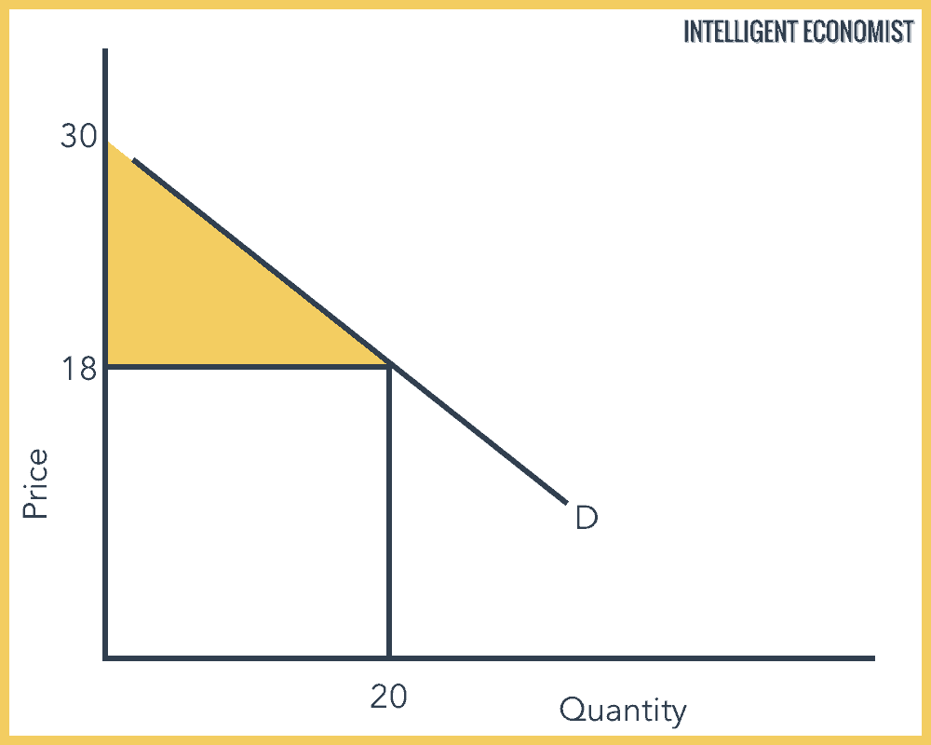
Consumer surplus graph

